Slide 1
Vehicle emission control
CAPSTONE PROJECT
Presented By:
Yuvanesh.v -university college of engineering,kanchipuram-mechanical engineering

Slide 2
OUTLINE
Problem Statement
Proposed System/Solution
System Development Approach
Algorithm & Deployment
Result
Conclusion
Future Scope
References

Slide 3
Problem Statement
In recent days global warming is increasing rapidly and one of the main contributor is vehicle emission
Green house gas (ghg) emission contributes 7.08 percent of all global emissions.
It ranks third amongst countries with the world's worst air quality.

Slide 4
Proposed Solution
By this project ,the analytics have given valuable insights on various factors,4wd cars produce more emission than 2wd.
The cars that give more than 10 miles per gallon(mpg)produces more emission.
Vehicles that run with more cylinders produce more emission..
Commonly 4 cylinder vehicles are used by more people and more emission is contributed by 4 cylinder vehicles.

Slide 5
System Approach
Building the proposed solution requires combination of data processing ,feature engineering ,data visualization
System requirements:
Hardware requirements:
Processor (CPU):
A multi-core processor is recommended, especially for handling large datasets and complex computations.
Software requirement :
An os compatable with the project to run it smooth (windows ,mac ,linux)

Slide 6
SYSTEM APPROACH
Library requirement:
Data processing and analysis:
Pandas , plotly
Data visualization:
plotly.graph_objects

Slide 7
Algorithm & Deployment
Data Collection: Gather data related to vehicle fuel economy and emissions. This data may include information such as vehicle make, model, year, engine displacement, fuel type, CO2 emissions, and fuel economy ratings.
Data Preprocessing: Perform data preprocessing tasks such as handling missing values, data cleaning, and feature engineering. Convert categorical variables into numerical representations if needed.
Exploratory Data Analysis (EDA): Conduct EDA to understand the distribution of variables, identify patterns, correlations, and outliers in the data. Visualize the data using plots such as histograms, scatter plots, and box plots.
Feature Selection: Select relevant features that contribute significantly to predicting fuel economy and emissions. Use techniques such as correlation analysis, feature importance, or domain knowledge to identify important features.

Slide 8
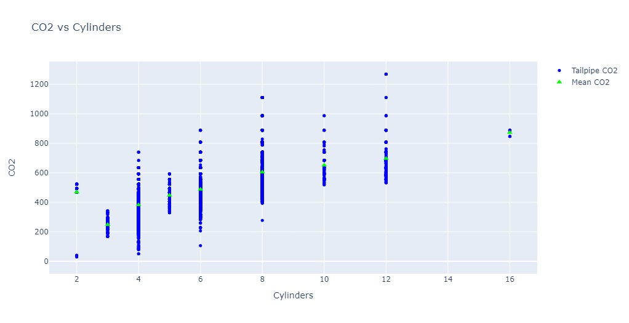
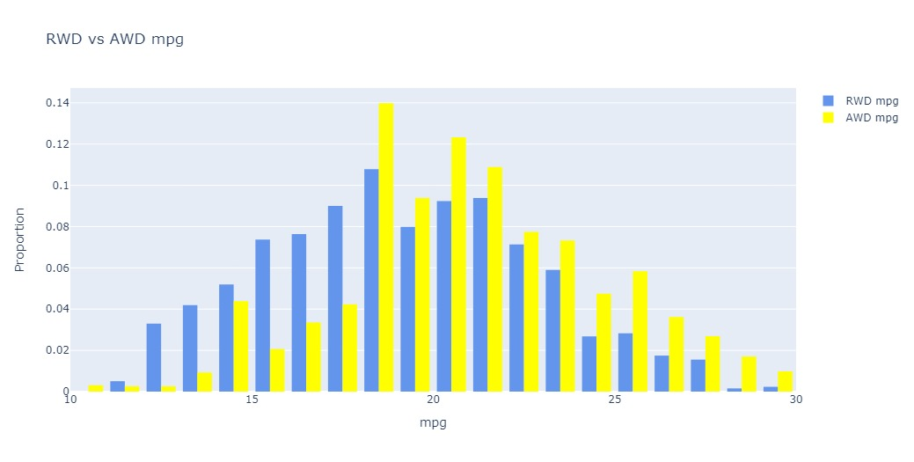
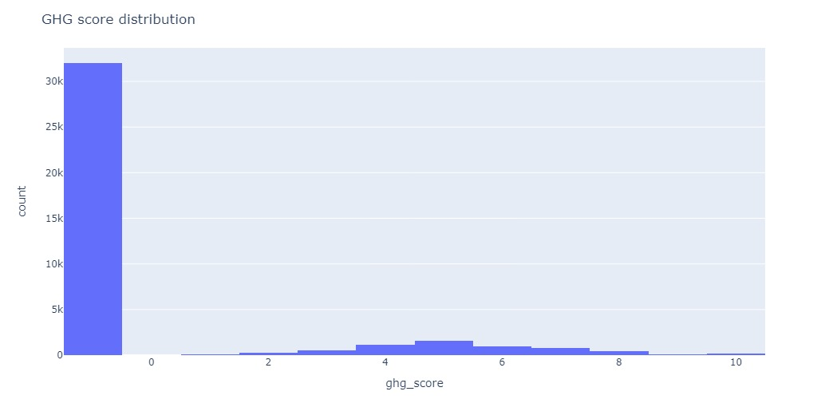
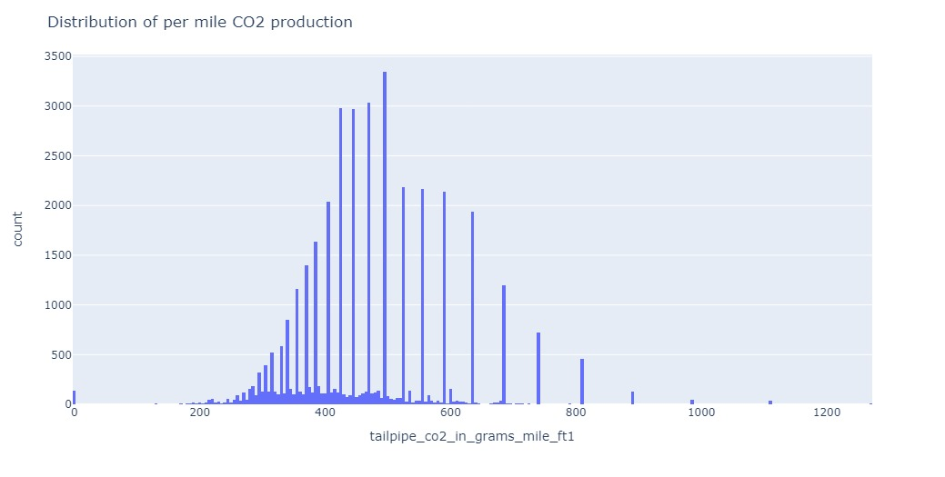
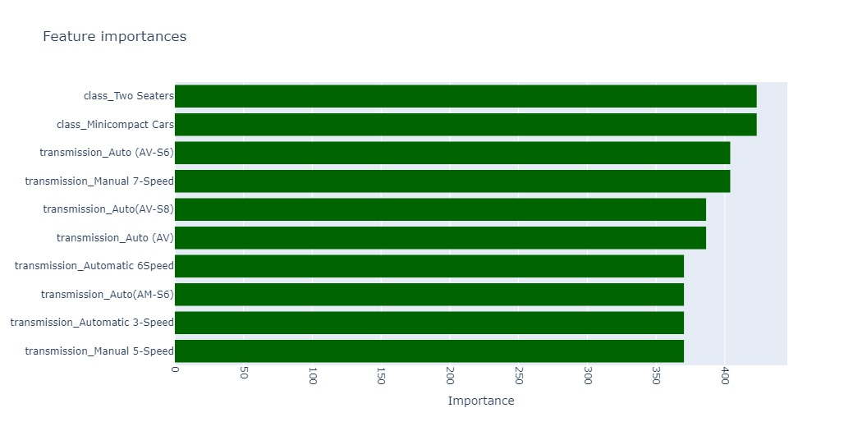
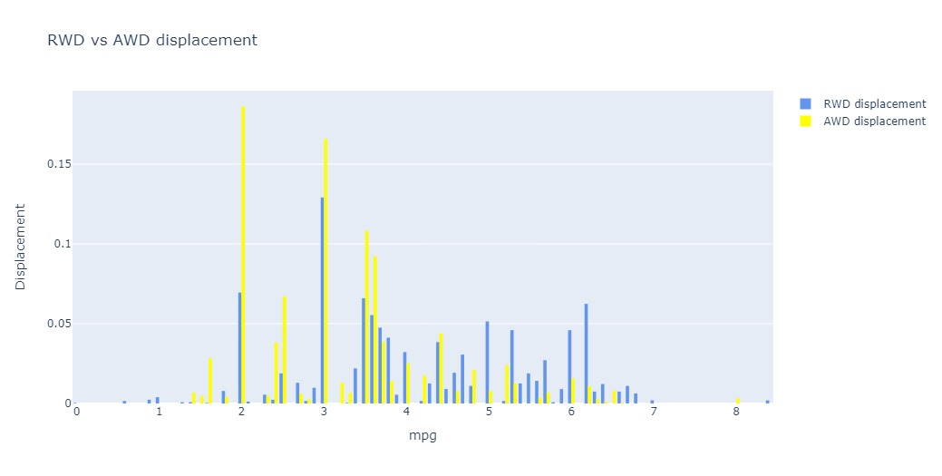
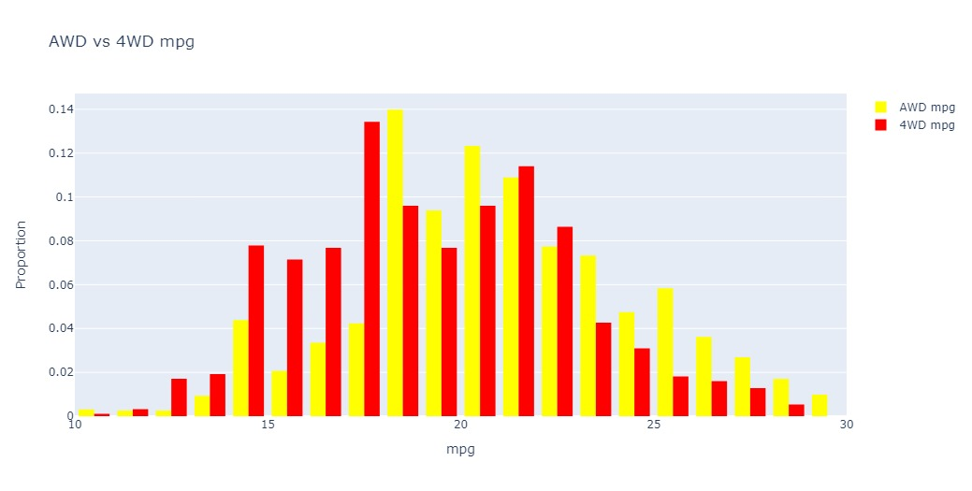
Result

Slide 9
Conclusion
Developing a new prototype and obtaining a new solution through the gathered report of vehicle emissions of different vehicle
The submitted reports and analysis concludes to control emission effectively by adopting suitable methods.

Slide 10
Future scope
Integration with Smart Transportation Systems: Integrate the fuel emission prediction model with smart transportation systems to provide real-time insights into vehicle emissions. This integration can help city planners, traffic management authorities, and policymakers make data-driven decisions to reduce overall emissions and improve air quality.
Predictive Maintenance: Extend the model to predict vehicle emissions based on factors such as engine health, maintenance history, and driving patterns. This predictive maintenance approach can help vehicle owners and fleet managers identify potential emission issues early and take preventive actions to reduce emissions and improve fuel efficiency.
Incorporation of Environmental Factors: Enhance the model by incorporating environmental factors such as weather conditions, temperature, humidity, and air quality index. By considering these factors, the model can provide more accurate predictions of vehicle emissions under different environmental conditions and help individuals and organizations make informed decisions about vehicle usage.

Slide 11
References
CO2 Emission by Vehicles (kaggle.com)
https://youtu.be/GsfT2sv_zCo?si=qS2oDx53YumU0T4k

Slide 12
THANK YOU

